Slide 1







Uber Data Analysis and Visualization
Name: Ajay Kumar.G
Batch code: MBT12

Slide 2



Introduction
Welcome to our presentation on the Uber data analysis project using Power BI.
This project leverages data visualization and analytics to uncover valuable insights into Uber's operations, trends, and performance metrics.
In this presentation, we will:
Explore how Power BI has been utilized to analyze and interpret Uber's data.
Highlight key findings, trends, and actionable insights derived from the dataset.
Demonstrate the power of data visualization in making informed business decisions.

Slide 3
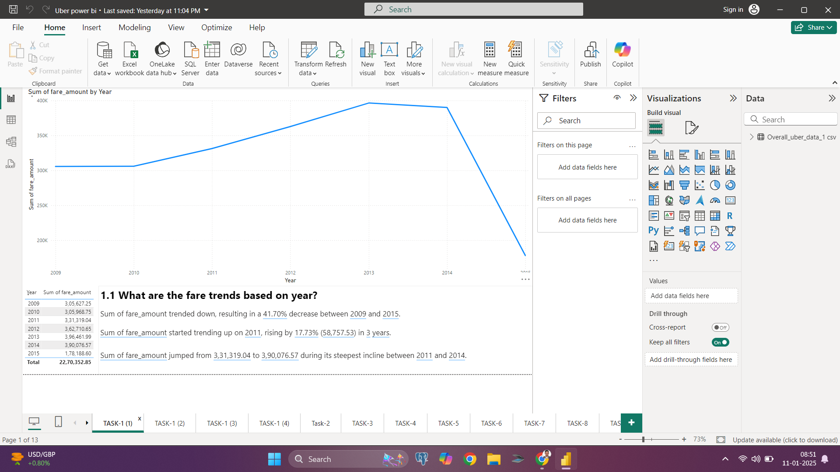



1.1 What are the fare trends based on year?
Conclusion: Yearly Trend Analysis: The fare amounts show a steady increase from 2010 to 2013, peaking in 2013. However, there is a significant drop in 2014, indicating a potential market shift or operational challenge.

Slide 4
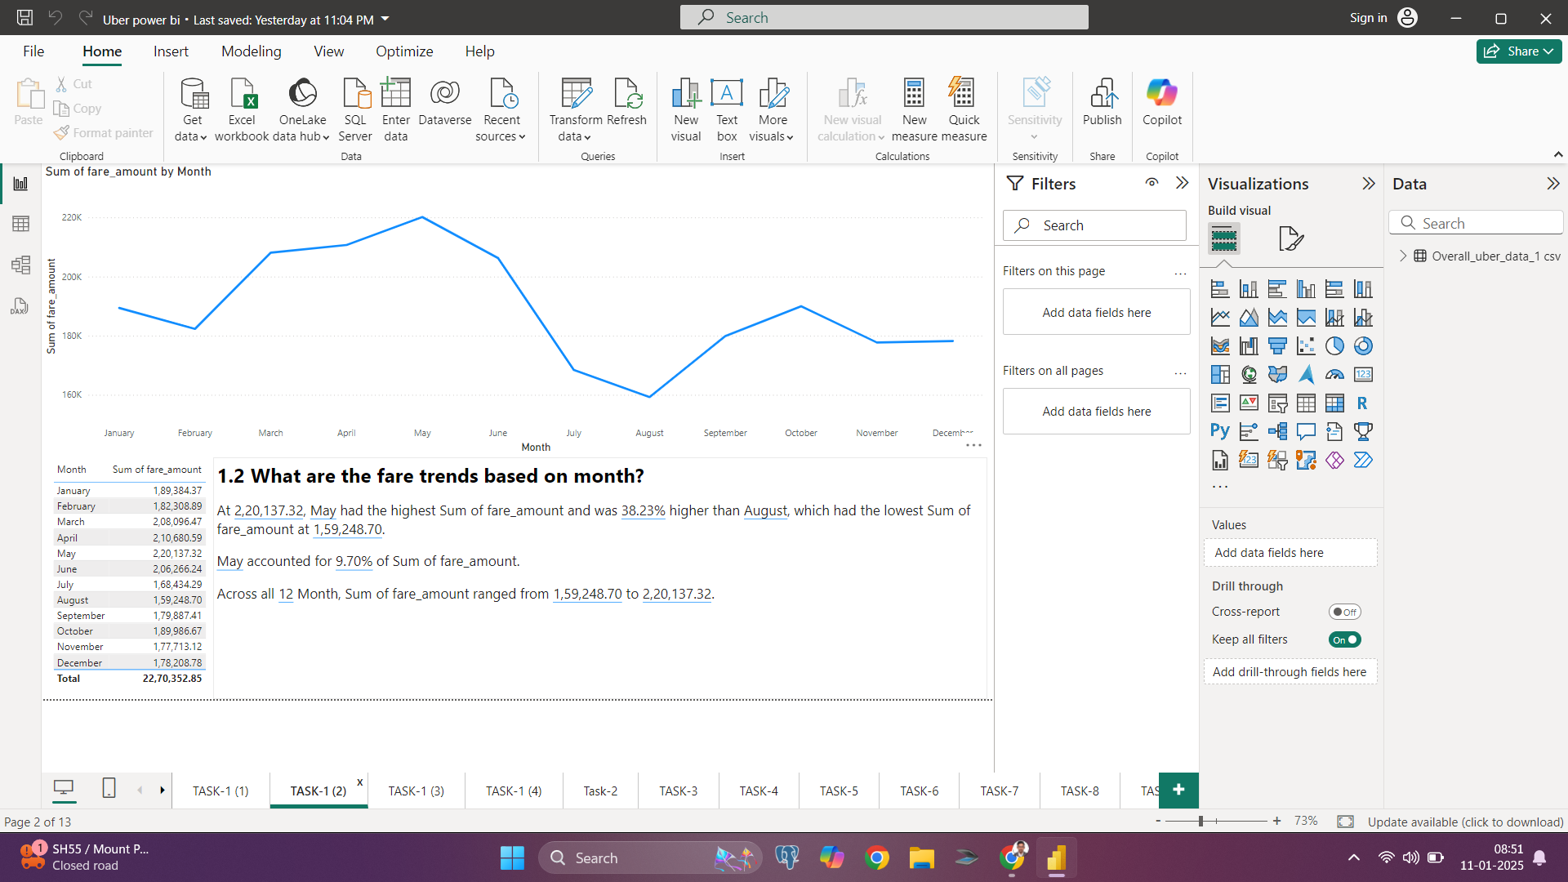


1.2 What are the fare trends based on months?
Conclusion: The fare trends fluctuate throughout the year, with a noticeable peak in May, followed by a decline in the summer months (June and July) before stabilizing towards the end of the year.

Slide 5
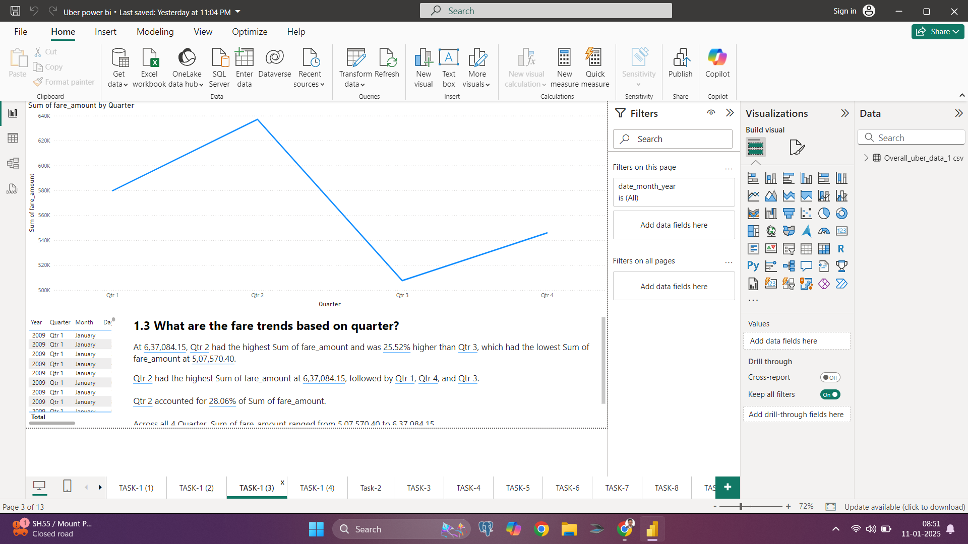


1.3 What are the fare trends based on Quarter?
Conclusion: The second quarter (Q2) exhibits the highest fare amounts, aligning with the peak in May. A sharp drop is observed in Q3, with a gradual recovery in Q4.

Slide 6
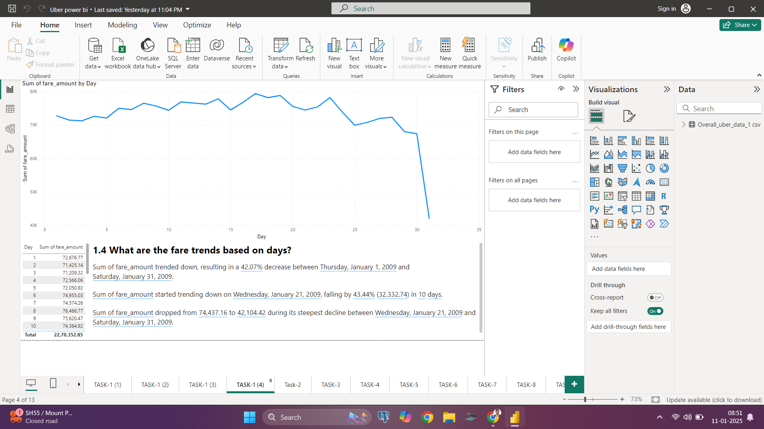
1.4 What are the fare trends based on Days?

Slide 7

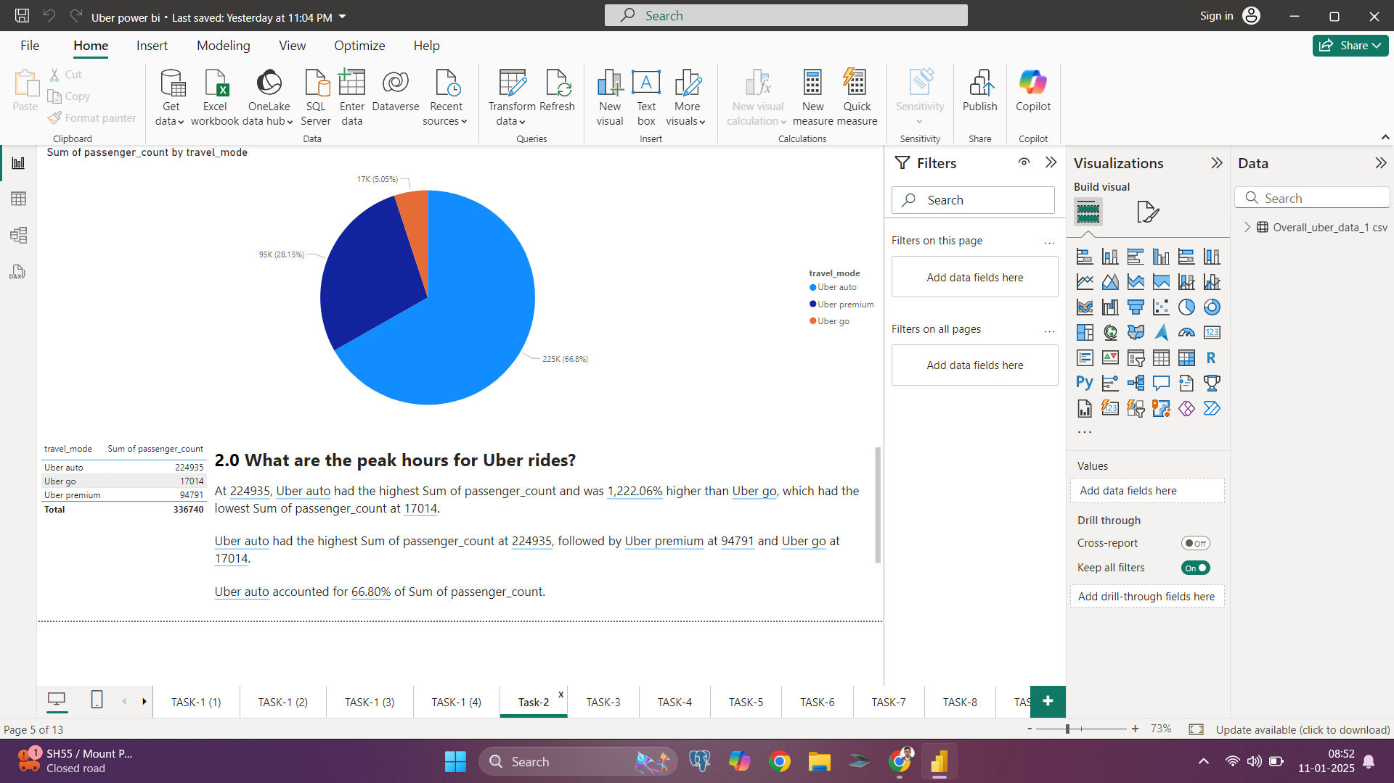

2.0 Which travel mode (Uber Go, Uber XUV, Uber Premium) is most popular?

Slide 8
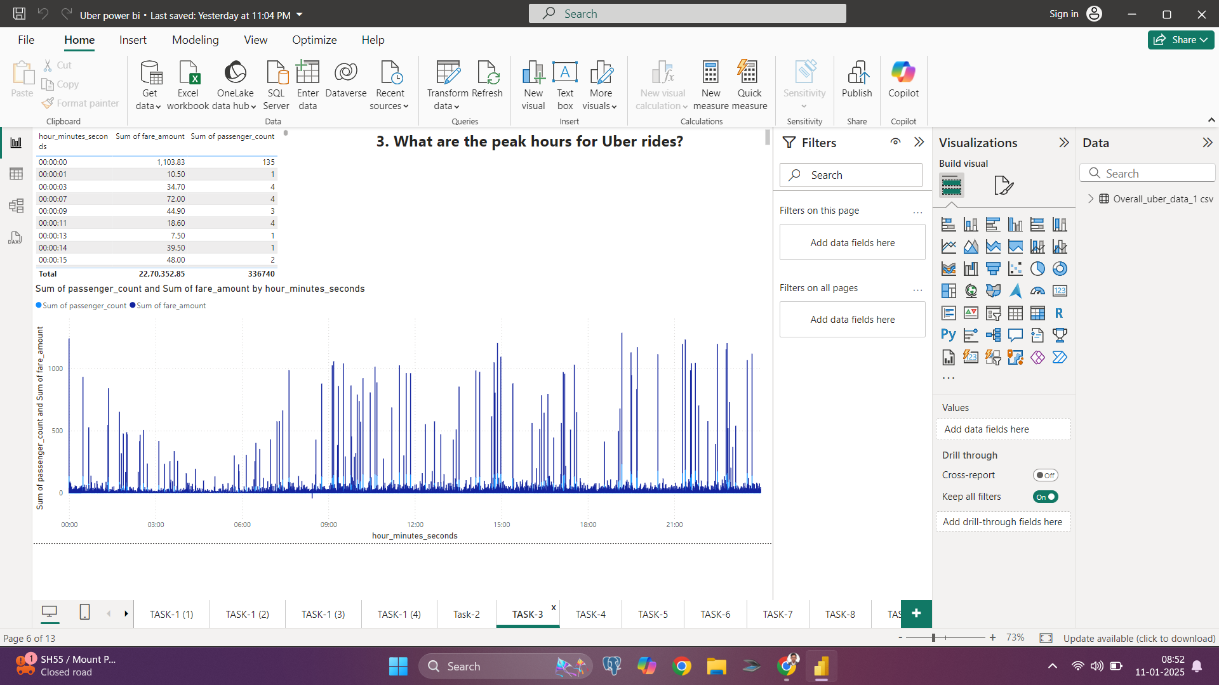
3.0 What are the peak hours for Uber rides

Slide 9
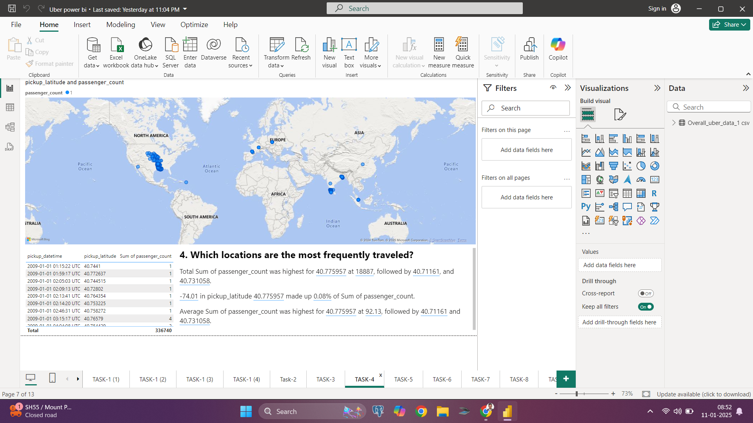
4.0 Which locations are the most frequently traveled

Slide 10
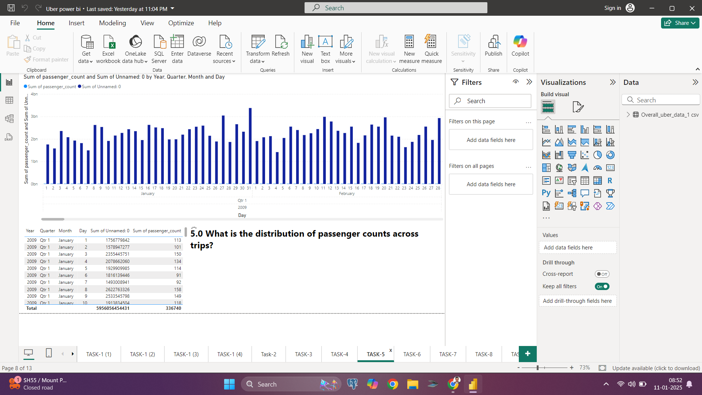
5.0 What is the distribution of passenger counts across trips

Slide 11
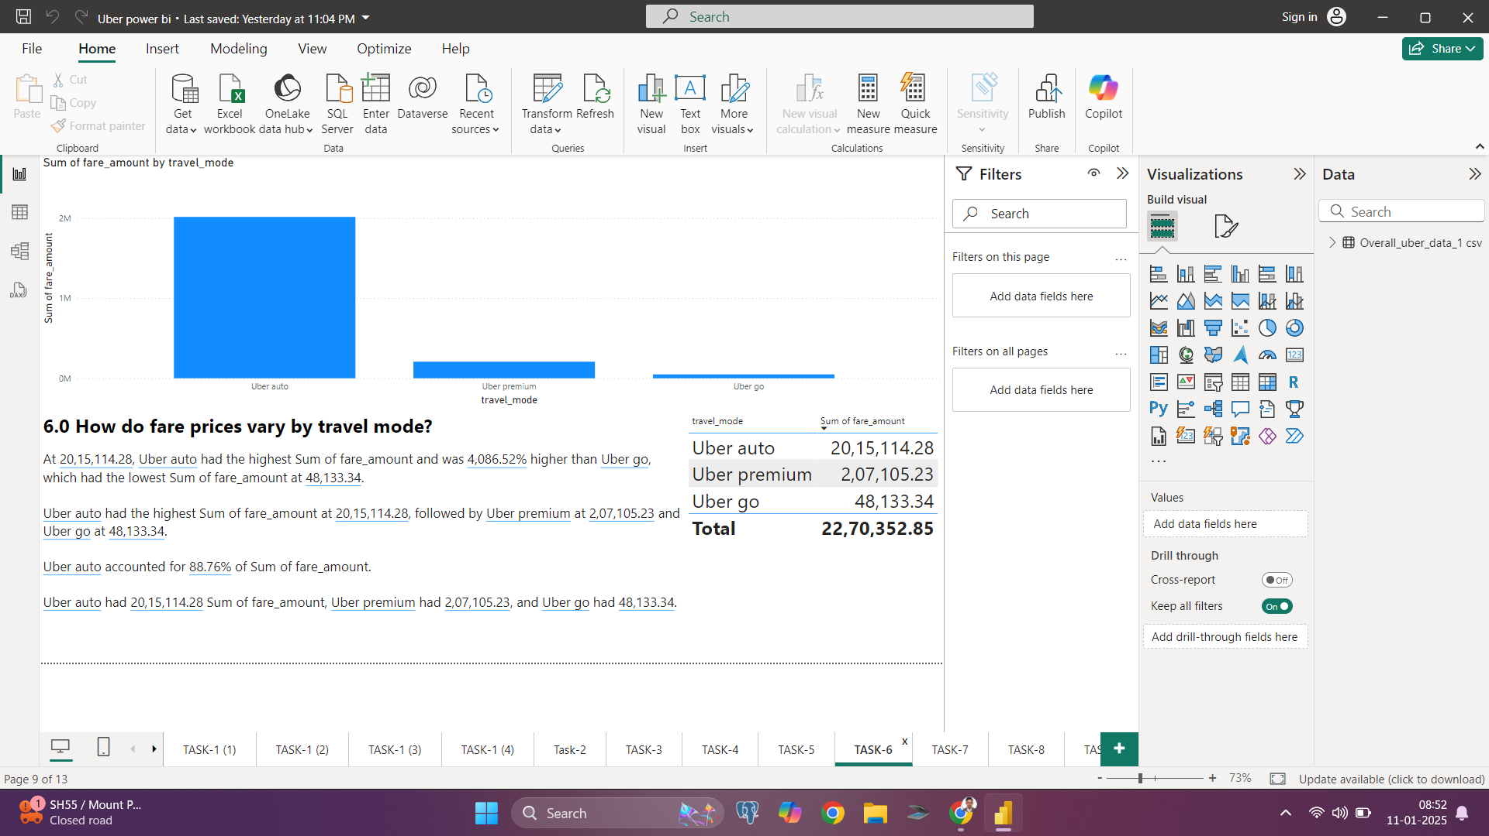
6.0 How do fare prices vary by travel mode

Slide 12
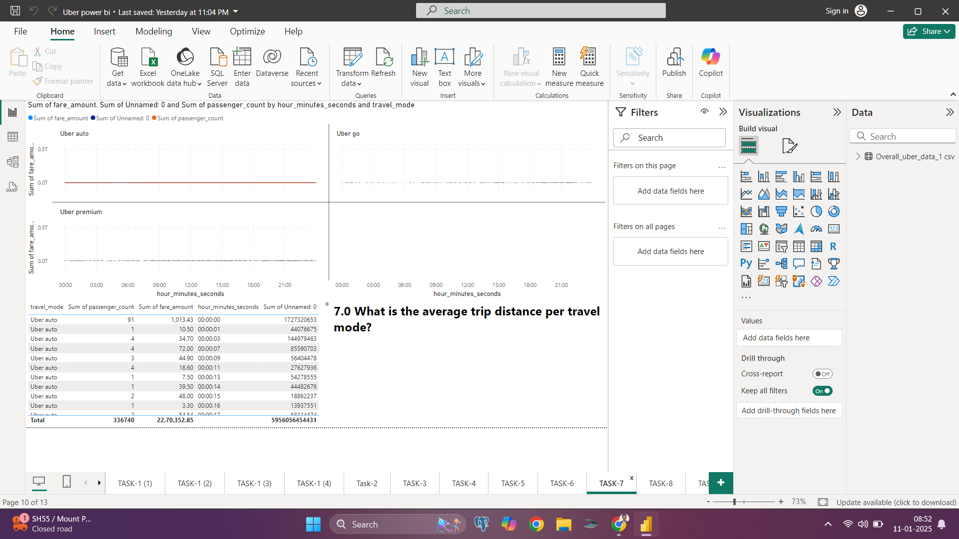
7.0 What is the average trip distance per travel mode?

Slide 13
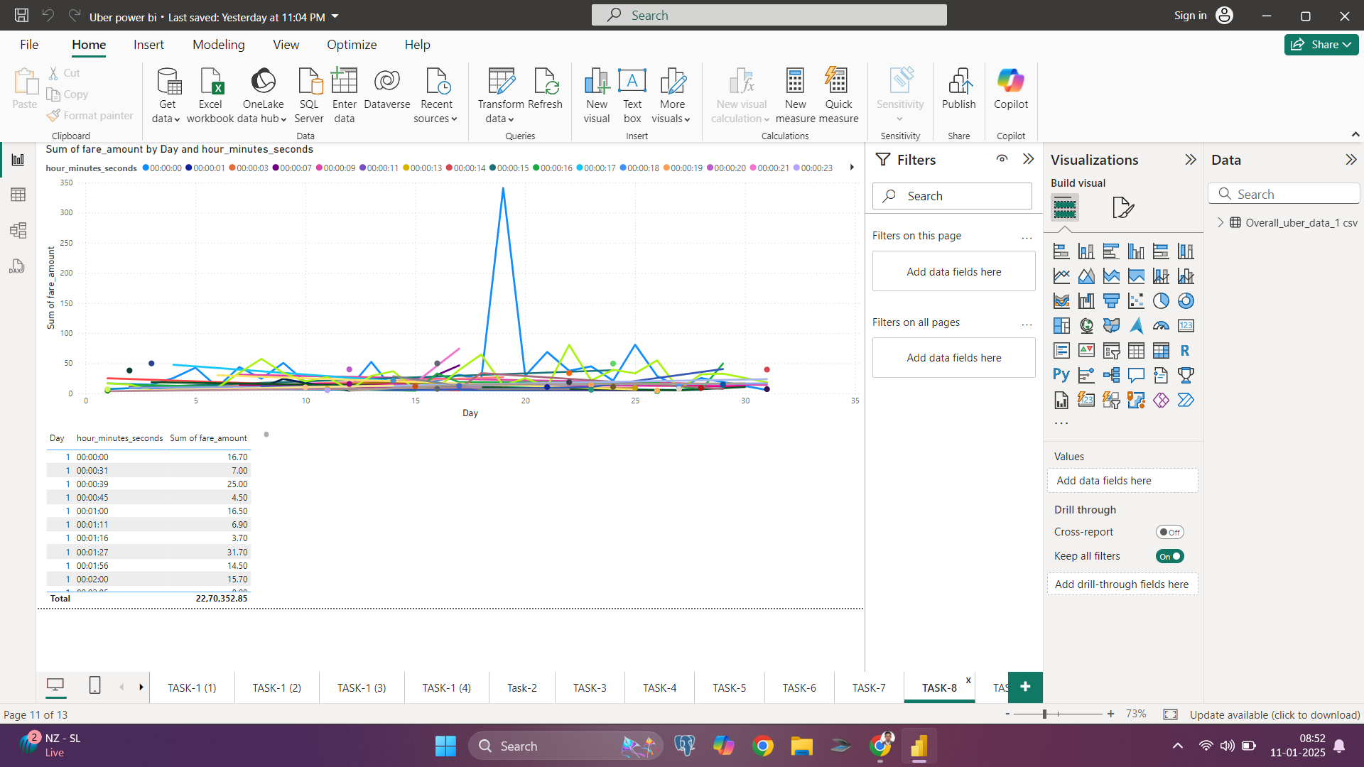
8.0 How does fare price vary by time of day

Slide 15
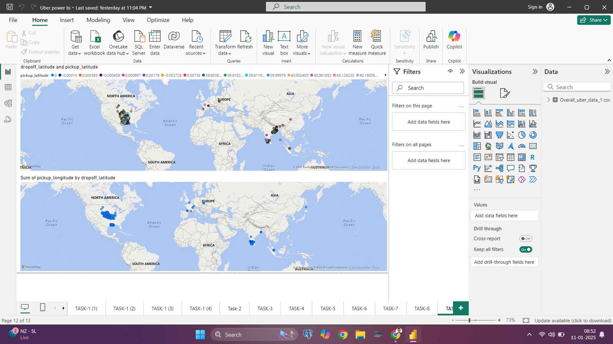
10.0 What is the average fare for rides starting or ending at specific locations

Slide 16

Conclusion
Based on a preliminary review of the data:
Revenue Insights:
Analysis of the fare_amount column can reveal trends in revenue generation across different times, locations, and modes of travel.
Passenger Behavior:
The passenger_count data allows us to identify peak usage trends and preferred group sizes, aiding in demand forecasting.
Geospatial Analysis:
Using pickup and dropoff coordinates, we can map high-demand zones, optimize routes, and identify areas requiring better service availability.
Temporal Trends:
Insights from pickup_datetime and hour_minutes_seconds can highlight peak travel hours and seasonal patterns for service optimization.
Travel Modes:
The travel_mode column offers an opportunity to compare usage and profitability across different Uber services, enabling targeted marketing and service adjustments.
Final Thought
This dataset provides valuable opportunities for understanding Uber's operations, optimizing resource allocation, and enhancing customer satisfaction. A deeper dive into the data will yield actionable insights for strategic decision-making.
Let me know if you’d like me to generate specific analyses, charts, or dashboards! ​

Slide 17
Thank You

